Slide 1


Learning Successor Representations
(i) A generalized HPC model for learning SR
(ii) Hebbian plasticity as an approximation to learning SR
Tom George
Will de Cothi, Kim Stachenfeld & Caswell Barry

Slide 2

Successor theory
•
not
Cheap dot-product
over states.
If R(s) changes, all is not lost!
•
Discounted sum of future occupancies
TD learnable
•
1

Slide 3


Successor theory and why hippocampus
HOME
THAT ANNOYING
POT HOLE R=-5
•
•
STARBUCKS
R=+10
BARRY LAB
PUB NIGHT
R=+100
•
1

Slide 4
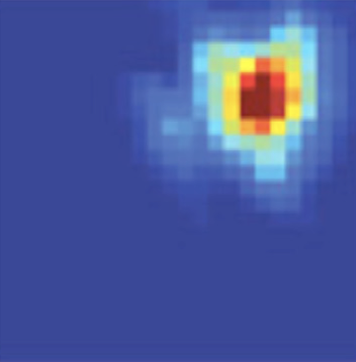
Successor theory and why hippocampus
•
•
•
1

Slide 5
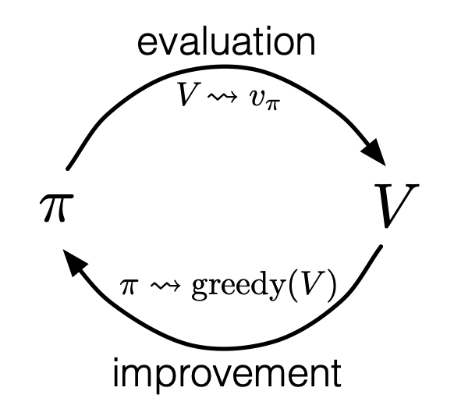
Successor theory and why hippocampus
•
Fixed policy:
Policies often are fixed
Value learning still useful
Policy iteration:
•
•
1

Slide 6
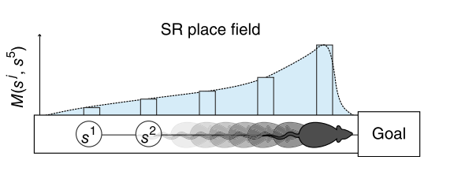
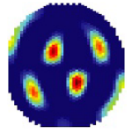
Successor theory and why hippocampus
PLACE CELLS:
= “how well does state s predict future occurrence of state s’ “
•
•
GRID CELLS:
Encodes how locations connectivity.
M eigenvectors encode a spatial metric…aka grid cells
•
1

Slide 7
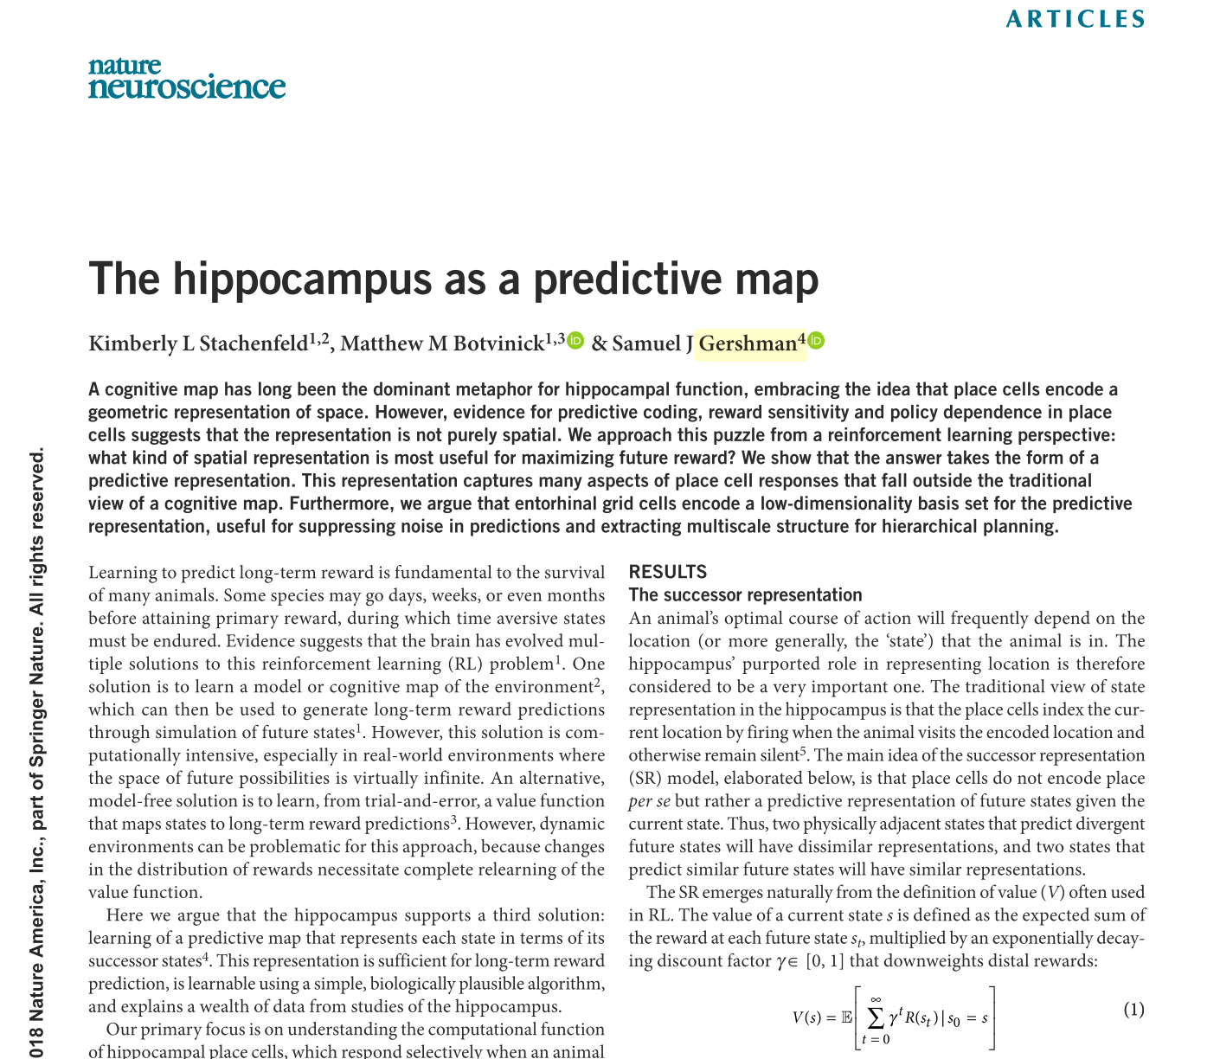
Successor theory and why hippocampus
PLACE CELLS:
= “how well does state s predict future occurrence of state s’ “
•
•
GRID CELLS:
Encodes how locations connectivity.
M eigenvectors encode a spatial metric…aka grid cells
•
1

Slide 8
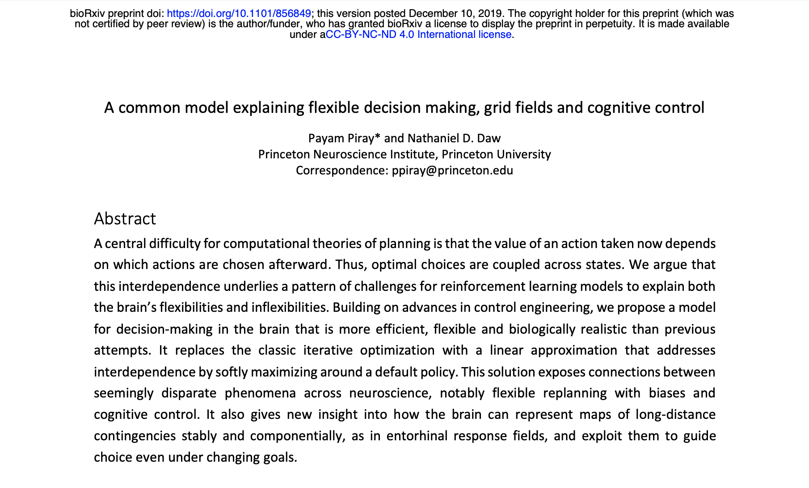
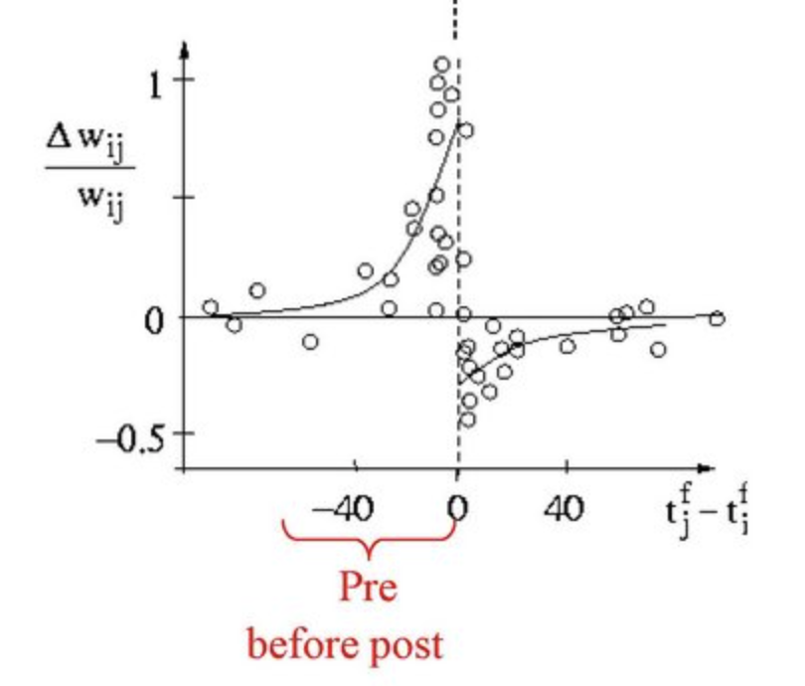

Successor theory and why hippocampus
(1)
Insert favourite RL rule
here…
(2)
We don’t learn it!
(3)
Hebbian STDP
We actually have to
learn this, somehow?
•
1

Slide 9
Roadmap
A state-general, space-and-time-continuous TD learning rule for SR
STDP as an approach to learning SR

Slide 10
Roadmap
A state-general, space-and-time-continuous TD learning rule for SR
STDP as an approach to learning SR

Slide 11
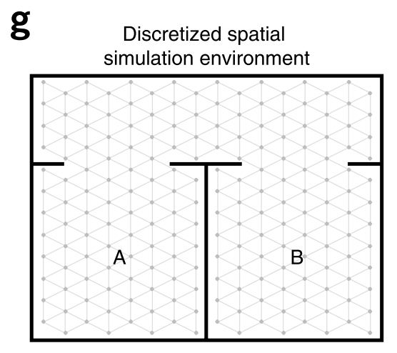

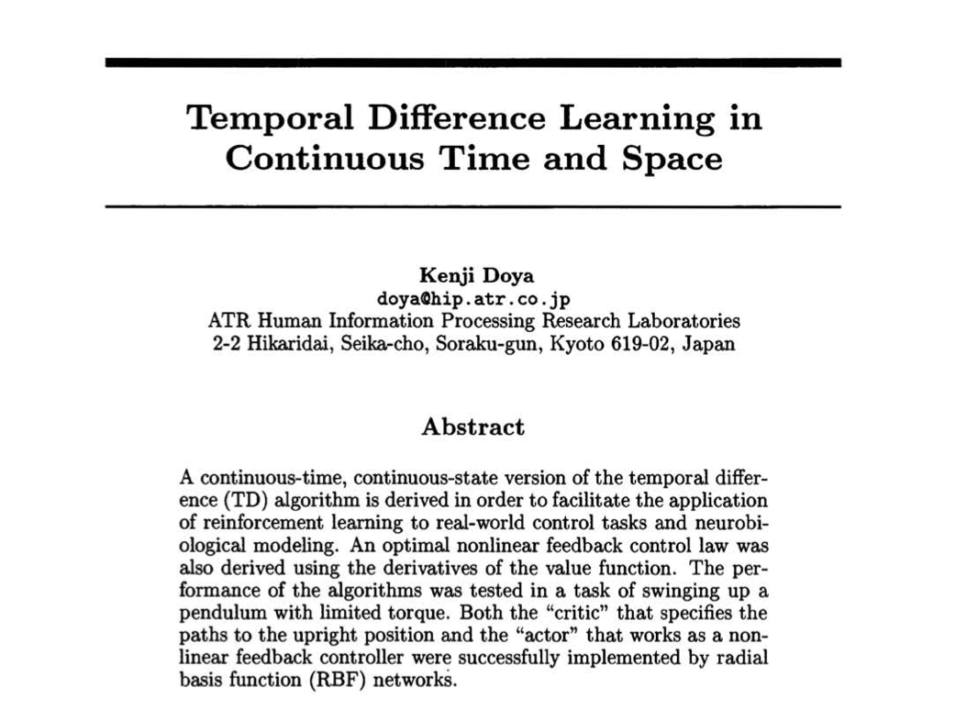

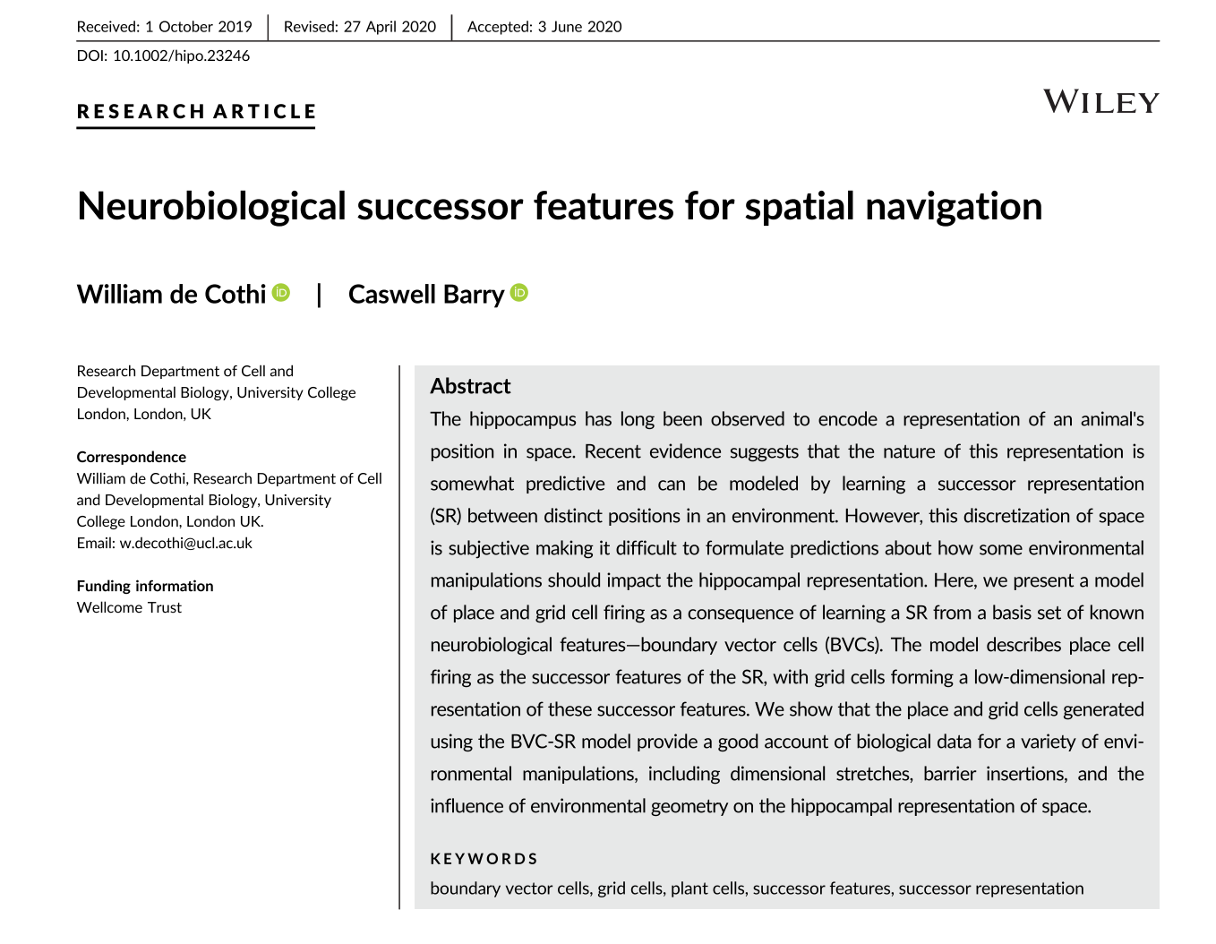

Three problems with SR models
(1)
Discrete in space
Trivial solution
(2)
Discrete in time
(3)
One-hot’s only

Slide 12
Flexible and plausible state representations
Non-one-hot analogue
Represented as linear combination of basis cells
Notational change: state s → population vector f
TASK: Learn M to improve ψ
• Least squares loss minimization
• Bootstrap TD update
stepSize
newEstimate
oldEstimate
stateToUpdate
TD error

Slide 13
Continuous time
Gamma is NOT independent of simulation time step, dt
Discrete time steps:
γ
f(x₀)
x₀
x₁
x₂
• • •
1

Slide 14
Continuous time
Continuous time:
exp (- dt / τ) = (1 - dt / τ)
f(x(t)) / τ
dt

Slide 15
Continuous time
Continuous time:
Examples where such flexibility might be useful:
Replay
Near rewards / decision points
Vary τ, e.g. longer in less interesting / more predictable environments
exp (- dt / τ) = (1 - dt / τ)
f(x(t)) / τ
dt

Slide 16
Final form of TD learning rule:
Continuous space
Continuous time
Generalised state representations

Slide 17
Definition of place fields:
Basic cells, f
M
eigenvectors of M
Place cells, PC
Grid cells, GC

Slide 18
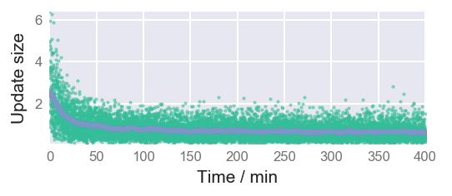
Single room exploration
Basis cells
30 secs
(but full exploration lasts ~2 hours)
Receptive field of
basis cell₁₁₇
Place cell₁₁₇
after exploration

Slide 19
Single room exploration – One hot

Slide 20
Grid cells of various length scales

Slide 21
Multiroom room exploration
Mixture of globally coherent and locally coherent grid cells

Slide 22
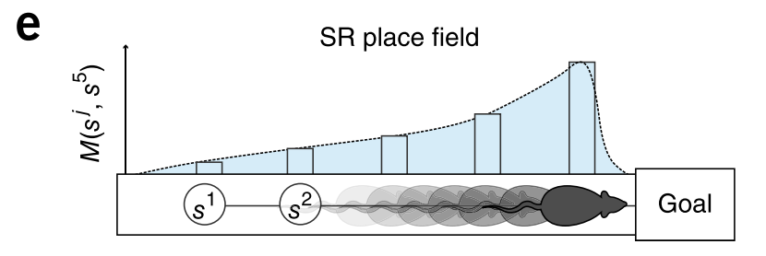



Behaviourally biased place cells: Loop maze
τ = 8s, v = 0.16m/s ==> PC size ~= 1.3m

Slide 23
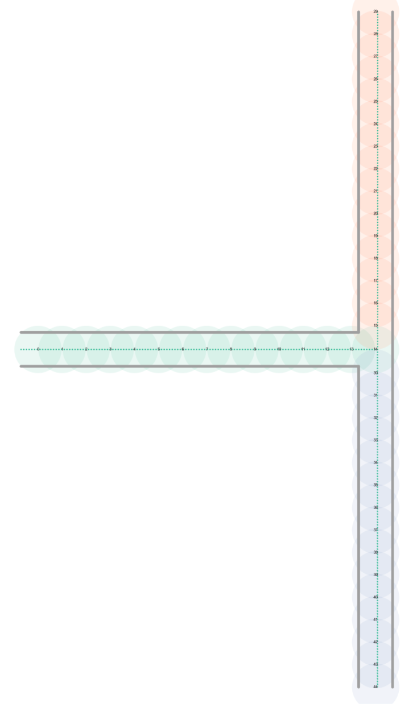
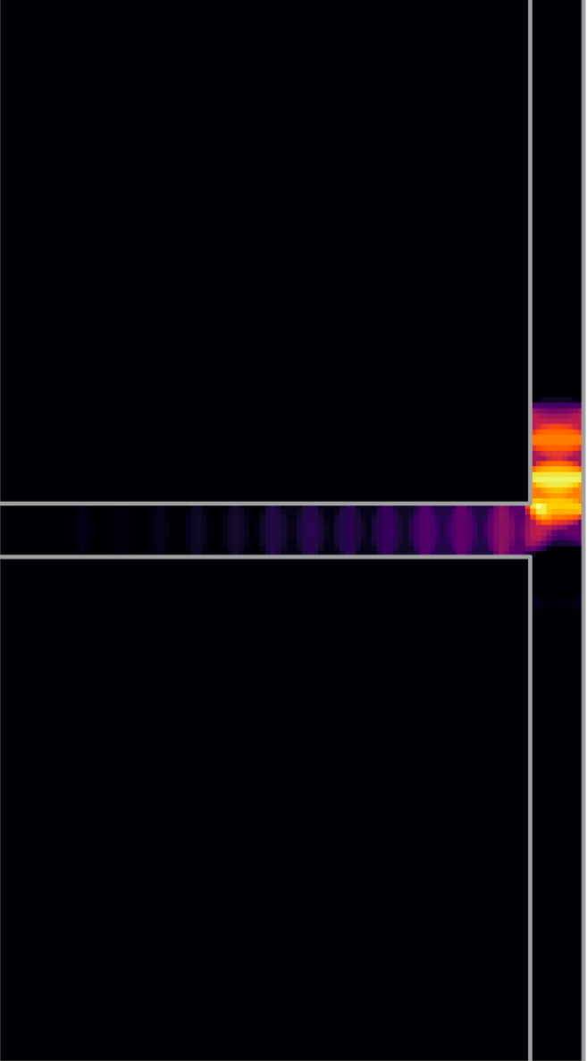
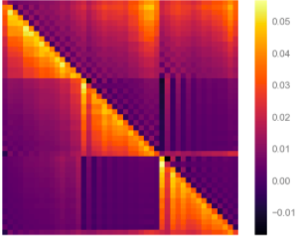
Behaviourally biased place cells: T-Maze
A place cell
Feature cells
Successor matrix
66%
34%

Slide 24
Conclusions:
Flexible model of SR learning (probably over detailed)
Capable of reproducing “classic” place/grid cell results + more
Olfactory Cortex
IT Cortex
Future directions:
Replay
Mixture of spatial and sensory input features
Non-linear model of successor features
Sensory inputs
Non-linear(?)
Sensory drive
Sensory drive
Vector navigation
Place
Grids
PCA

Slide 25
Roadmap
A state-general, space-and-time-continuous TD learning rule for SR
STDP as an approach to learning SR

Slide 26
Issues with learning via TD
Biologically how is this learning rule implemented
Is it necessary, aren’t most policies fairly simple

Slide 27

STDP: “cells that fire together, wire together”
Binding strength:
strong
weak
t
BINDING STRENGTHS
Presynaptic neuron
Postsynaptic neuron

Slide 28
STDP: “cells that fire together, wire together”
Binding strength:
strong
weak
WON’T WORK!
STDP time scale O(20ms)
Time to walk from to O(2s)
t
BINDING STRENGTHS
Presynaptic neuron
Postsynaptic neuron

Slide 29
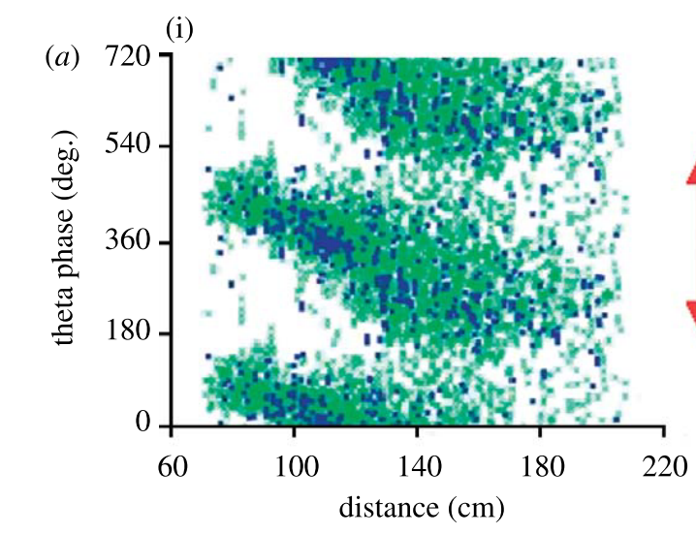
Theta sweeps represent predictions into the near future
t
Perhaps this can go some of the way
towards closing the gap

Slide 30
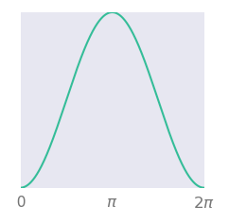
Theta modulation
Place field
Theta phase =
Preferred phase
(neuron i)
Rat path
Firing rate =
20Hz
Place cell firing rate
( = 1 in centre of cell)
Theta modulation,
(=1 at preferred theta phase)

Slide 31
Theta sweeps

Slide 32
Inhomogeneous Poisson spike train sampling
Simulation saves firing rate.
Spike train sampling and STDP done post hoc
Zoom in and increase spike rate 10x

Slide 33
Online-STDP
20ms
strengthen
weaken
strengthen
a lot
weaken
a lot

Slide 34

Results
PLACE FIELD
Before learning
TD learning
STDP
After learning
GRID FIELDS

Slide 35
Some back of the envelope calculations
Theta sweeps forward one place cell distance, σ_{PC}, each cycle lasting T_{θ}
STDP binding occurs for τ_{STDP} of this
Distance into the future a cell can be bound:
“Time” into the future a rat can forecast:
This should be:
Roughly constant
O(few seconds) at least

Slide 36
We’re probably a little bit out on timescale
20ms
1m
8Hz
0.1m/s
Some solutions:
Very large place cells do exist
STDP learning restricted to rare ‘long range sweeps’
Maybe 1-2s SR is enough

Slide 37
It may be ~ constant though
20ms
1m
﻿Whishaw and Vanderwolf, 1973
8Hz
0.1m/s
Some solutions:
Very large place cells do exist
STDP learning restricted to rare ‘long range sweeps’
Maybe 1-2s SR is enough
Jeewajee & Barry et al., 2008
Jeewajee & Barry et al., 2008
﻿Maurer et al., 2012
(similar but not strictly what they found)

